Slide 1
File System Explorer
Integrantes:
Luis Molina
Carla Cardozo
Roger Mateu

Slide 2
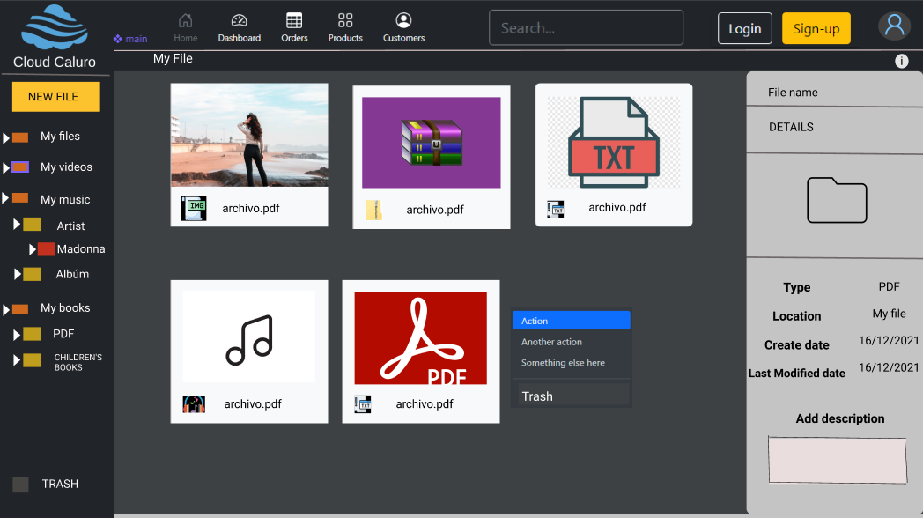
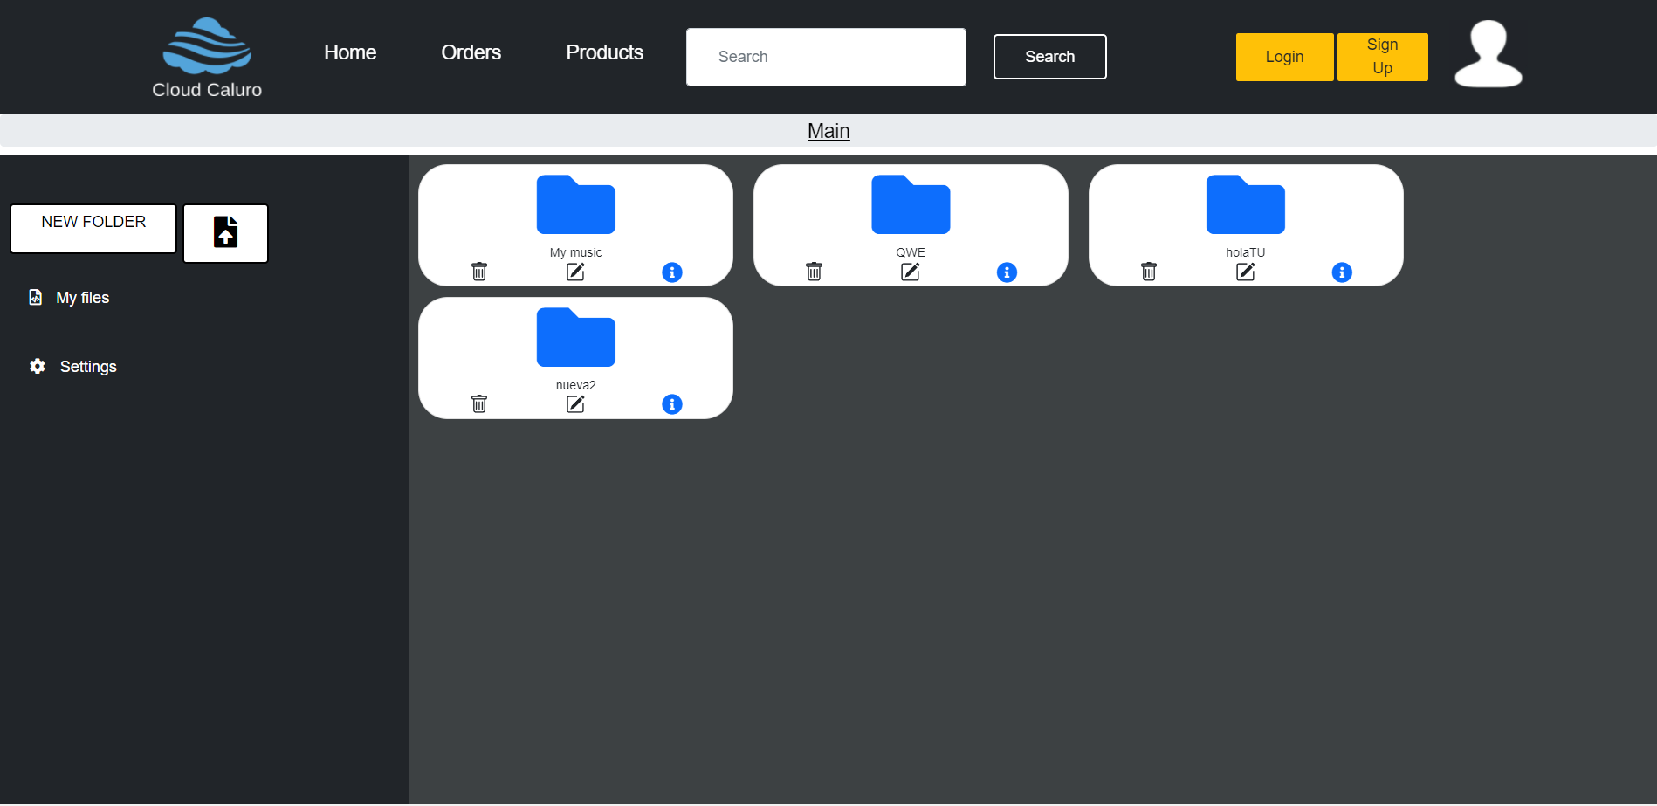
Wireframe
expectations reality

Slide 3
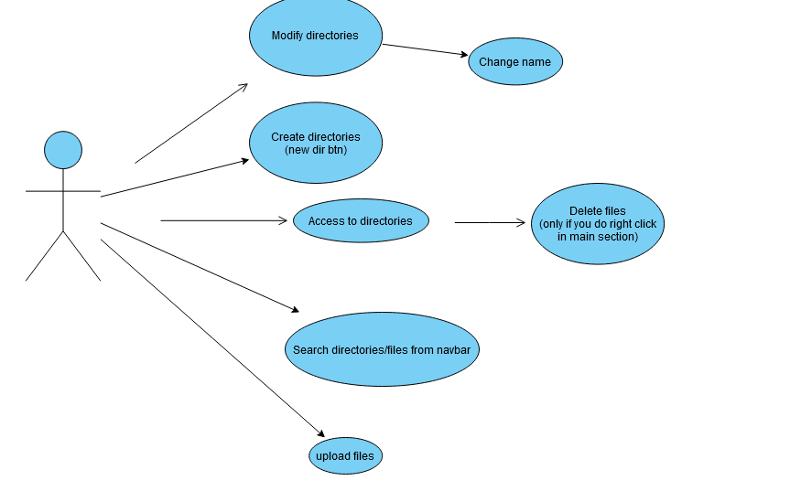
Diagram
We made it possible for the client to do almost all the functions, we lacked the folder search engine.

Slide 4
What lessons you’ve learned during this project
General use of PHP
The use of the global variables
Use of the keys
Working with files and folders
Use form

Slide 5
What problems have you encountered when developing this project?
Editing files
Deleting files
Show the information of the files
Display on the screen the files and the folders.

Slide 6
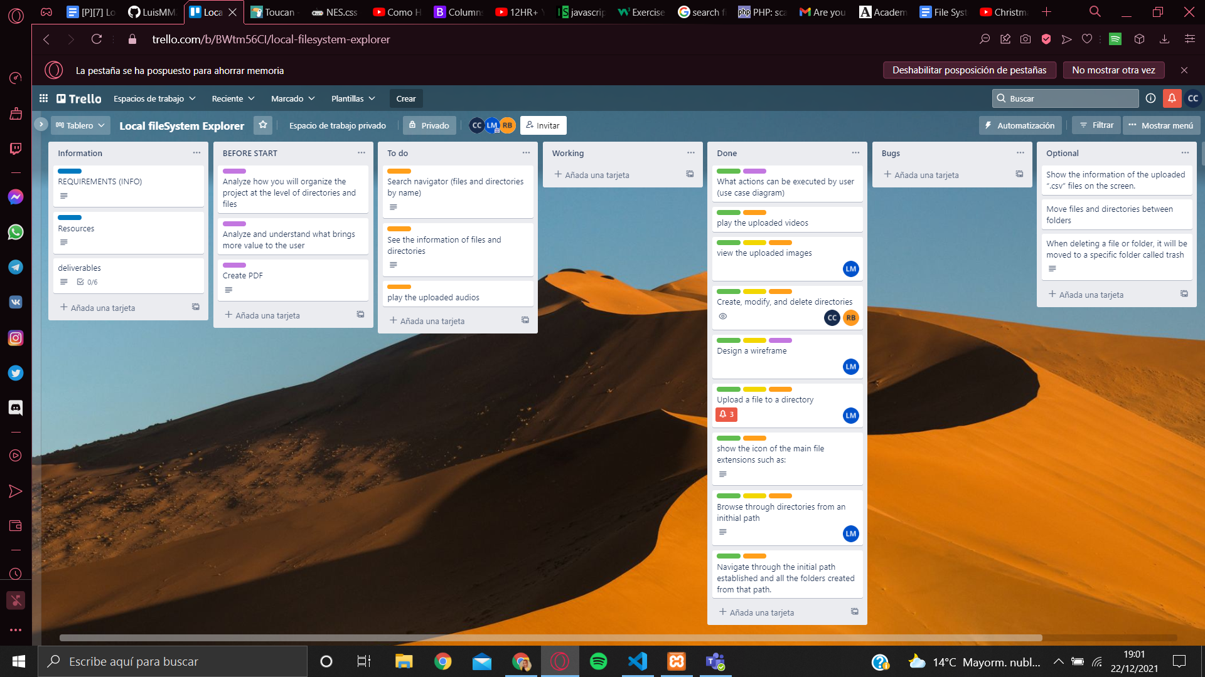
How you have organized and distributed the tasks

